Slide 1
Cascading Style Sheets- CSS “Add style to your web pages”

Slide 2




Team:
Sai Kiran
Doddapaneni
Nishanth Reddy Devi Reddy
Yeshwanth Reddy Anumula
Millinder Reddy
Maligi Reddy

Slide 3
Definition of CSS
CSS stands for Cascading Style Sheets
Styles - define how to display HTML elements
Styles are normally stored in Style Sheets
Definition:
Cascading Style Sheets (CSS) – is a style sheet language used for describing the look and formatting of a document written in a markup language. You write CSS rules in elements, and modify properties of those elements such as color, background color, width, border, font etc.

Slide 4
Syntax of CSS
The CSS syntax is made up of 5 parts:
Selector
Property/value
Declaration
Declaration block
Curly braces

Slide 5
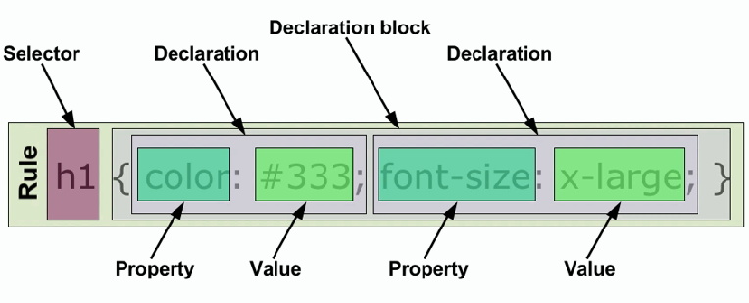

Slide 6
Selector
Selectors are used to declare which part of the markup a style applies to, a kind of match expression.
3 types of selectors
Tag selectors (body, p, div, a)
ID selectors (#wrapper, #sidebar)
Class selectors (.content, .menu)
NOTE:
-The selector is normally the HTML element you want to style
-Selectors should never start with a number, nor should they have spaces in them

Slide 7
ID Selector
The id selector is used to specify a style for a single, unique element.
The id selector uses the id attribute of the HTML element, and is defined with a "#".

Slide 8
The style rule below will be applied to the element with id=“ppt”:
#ppt
{
text-align: center;
border:1px solid red;
Width: 200px;
Height: 100px
}

Slide 9
Class Selector
The class selector is used to specify a style for a group of elements. Unlike the id selector, the class selector is most often used on several elements.
This allows you to set a particular style for many HTML elements with the same class.
The class selector uses the HTML class attribute, and is defined with a "."
In the example below, all HTML elements with class="center" will be center-aligned

Slide 10
IN HTML FILE:
<h1 class="center">Center-aligned heading</h1>
<p class="center">Center-aligned paragraph.</p>
IN CSS FILE:
.center {text-align:center;}

Slide 11
How CSS is Applied to A Web Page
There are three ways of inserting a style sheet:
Inline style
Internal style sheet
External style sheet

Slide 12
Inline style
An inline style loses many of the advantages of style sheets by mixing content with presentation. Use this method sparingly!
To use inline styles you use the style attribute in the relevant tag. The style attribute can contain any CSS property. The example shows how to change the color and the left margin of a paragraph
<p style=“text-align: center; font- weight: bold; color: yellow;”>This is a paragraph.</p>

Slide 13
Internal style sheet
An internal style sheet should be used when a single document has a unique style. You define internal styles in the head section of an HTML page, by using the <style> tag, like this:
<head>
<style type=“text/css”>
p {margin-left:20px;}
</style>
</head>

Slide 14
External style sheet
An external style sheet is ideal when the style is applied to many pages. With an external style sheet, you can change the look of an entire Web site by changing one file. Each page must link to the style sheet using the <link> tag. The <link> tag goes inside the head section:
<head>
<link rel="stylesheet" type="text/css" href="style.css">
<link rel="stylesheet" type="text/css" href="mystyle.css">
</head>

Slide 15
Cascading order
Browser default
External style sheet
Internal style sheet (in the head section)
Inline style (inside an HTML element)
An inline style (inside an HTML element) has the highest priority, which means that it will override a style defined inside the <head> tag, or in an external style sheet, or in a browser

Slide 16
CSS Box Model
All HTML elements can be considered as boxes. In CSS, the term "box model" is used when talking about design and layout.
The CSS box model is essentially a box that wraps around HTML elements, and it consists of: margins, borders, padding, and the actual content.
The box model allows us to place a border around elements and space elements in relation to other elements.

Slide 17
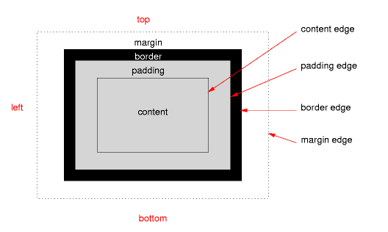
CSS Box Model

Slide 18
Margin, Padding, Border and Content
Explanation of the different parts:
Margin - Clears an area around the border. The margin does not have a background color, it is completely transparent
Border - A border that goes around the padding and content. The border is inherited from the color property of the box
Padding - Clears an area around the content. The padding is affected by the background color of the box
Content - The content of the box, where text and images appear

Slide 19
Advantages
CSS Saves a Lot of Work!
CSS defines HOW HTML elements are to be displayed.
Styles are normally saved in external .css files. External style sheets enable you to change the appearance and layout of all the pages in a Web site, just by editing one single file!
Site-wide consistency

Slide 20
Animista:
This website contains CSS animations on-demand.
Open the link below:
http://animista.net/

Slide 21
Flexbox froggy : simple css game. https://flexboxfroggy.com

Slide 22
References:
Spinkit : http://tobiasahlin.com/spinkit/
Powershow : https://www.powershow.comg
Animista: http://animista.net/
Flexbox froggy: https://flexboxfroggy.com

Slide 23
Thank you,
Any queries?.

